Slide 1
Setting IDOR vulnerable Java web app
By
Kathirvel K

Slide 2

Table of Contents
What is IDOR?
Why it matters and impact?
Owasp Top 10
Our Vulnerable shopping web app
Exploitation
Why it is vulnerable?
Security controls

Slide 3
IDOR
What is IDOR?
IDOR is a logical / access control bug, not a technical bug.
The logic of authorization is missing or flawed.
The vulnerability exists because the app doesn't verify that the user is allowed to access that resource.
Insecure Direct Object Reference (IDOR) is an access control vulnerability that arise when an application exposes direct references to internal objects (files, database records, URLs) without proper authorization checks.
It occurs when the server trusts a client-supplied object ID and retrieves the resource without verifying whether the authenticated user is authorized to access it.
Analogy...

Slide 4
Impacts of IDOR
Unauthorised Data access
Account takeover
Data manipulation
Lateral movement inside app

Slide 5
Why its matters?
IDOR is one of the most common and high-impact access control issues in modern web applications.
It is easy to exploit, but often hard to detect without proper logging or monitoring.
Developers frequently validate who you are (authentication) but forget to validate what you are allowed to access (authorization).

Slide 6
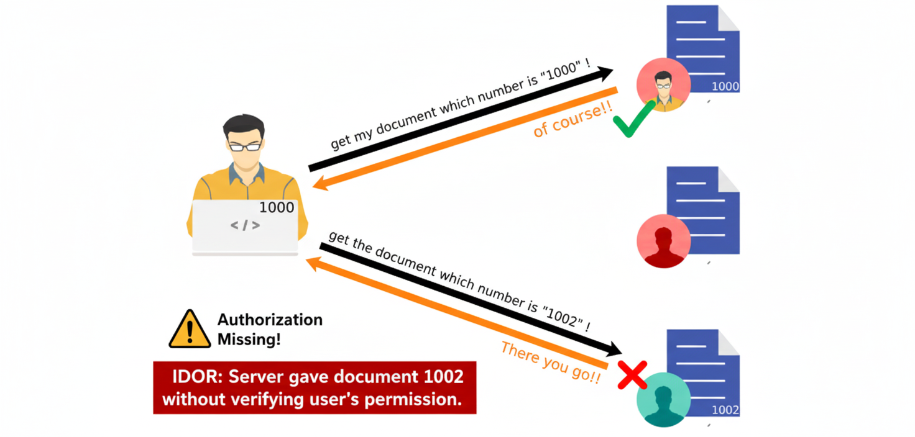
Attack flow
IDOR

Slide 7
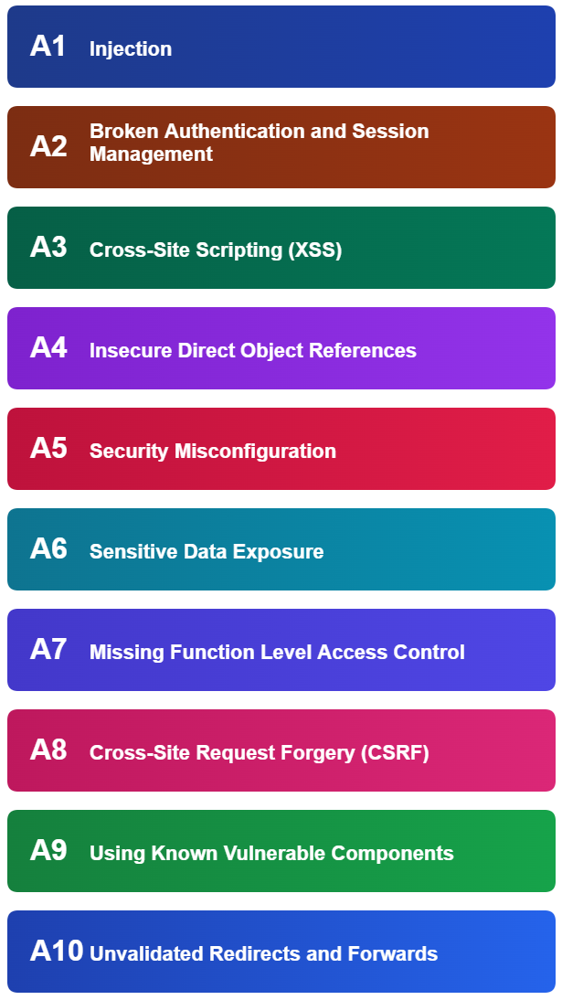
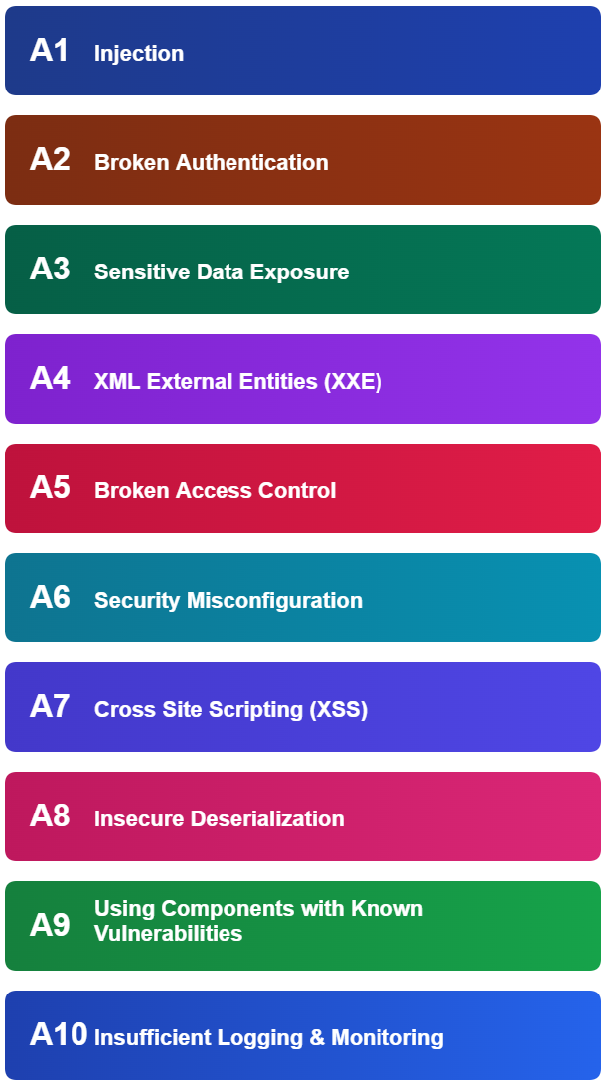
OWASP TOP 10 WEB - 2013
merged
OWASP TOP 10 WEB - 2017

Slide 8
IDOR Vulnerable Java Web app
Application overview

Slide 9
IDOR Vulnerable modules?
Profile
Change password
Edit user profile
Delete user account

Slide 10
Exploitation

Slide 11
Why its Vulnerable?
Missing authorization checks
Trusting client-side controls
Easily guessable objects

Slide 12
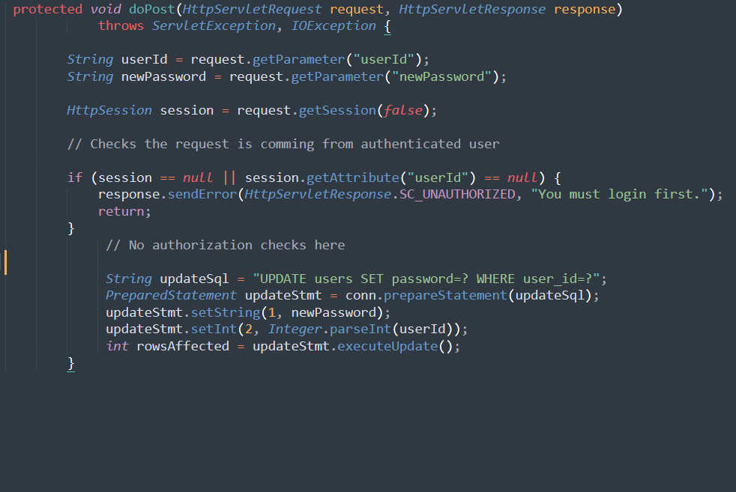
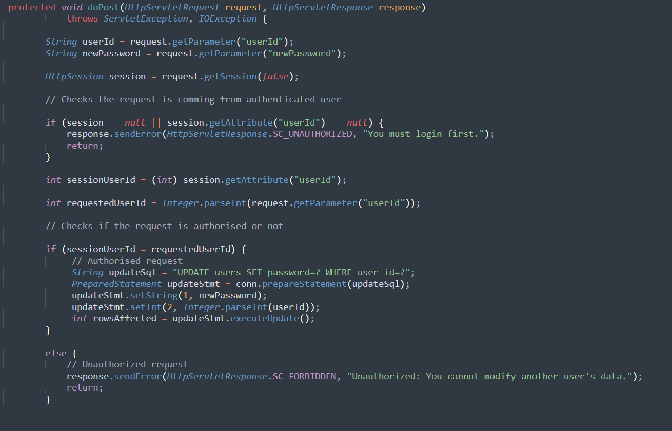
Vulnerable code
Secure code

Slide 13
Security controls
Detection control
Preventive control
Detailed Access Logging
SIEM Correlation Rules for Detecting sequential enumeration and Access to high-value objects by low-privilege users
WAF / API Gateway Monitoring
Anomaly detection
UEBA
Server-Side Access Validation
Use Indirect References
Role-Based Access Control (RBAC)
Secure Coding Standards and Code review
Least privilege principle
Manual and automated Testing

Slide 14
Logs needed for detection
Application logs with authentication, authorization, user activity logs
Web server logs
WAF logs

Slide 15
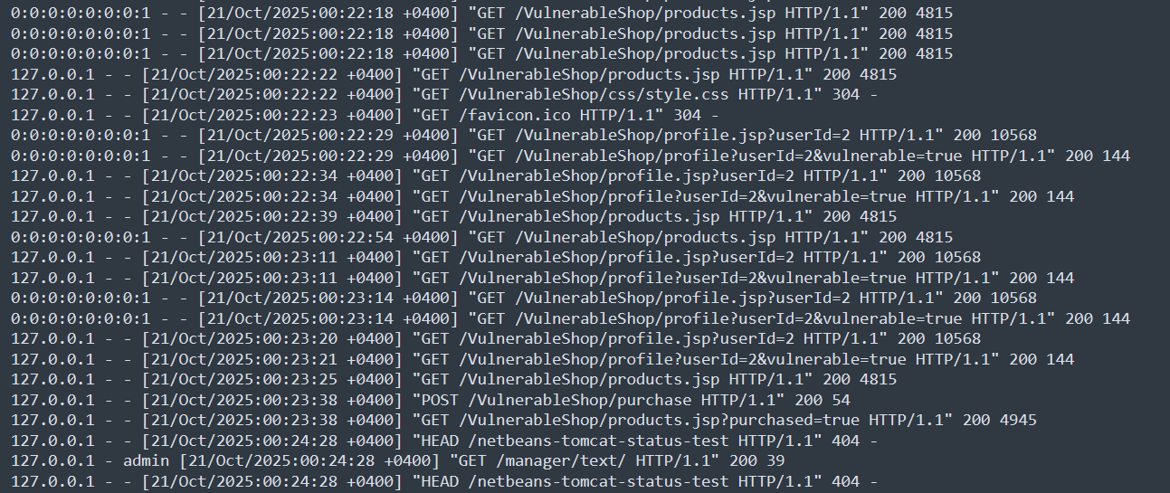
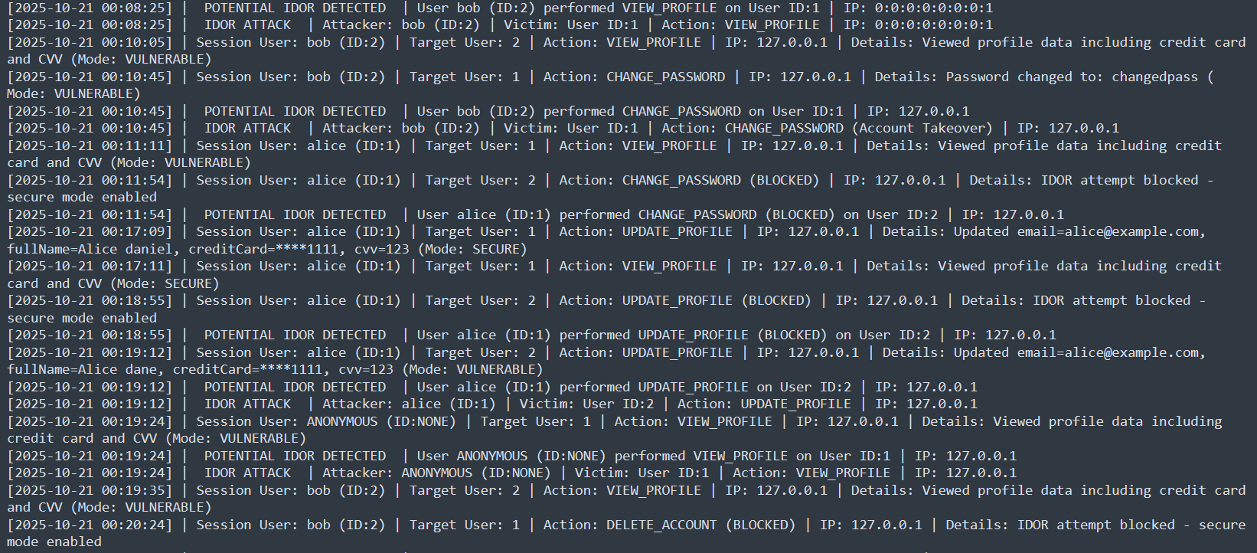

Web server
(Doesn’t have the required information)
Application access logs
(this logs have the information we required)

Slide 16
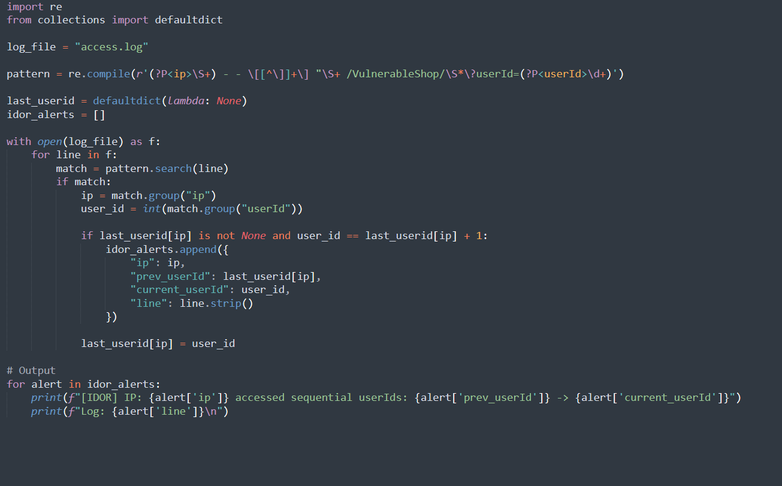
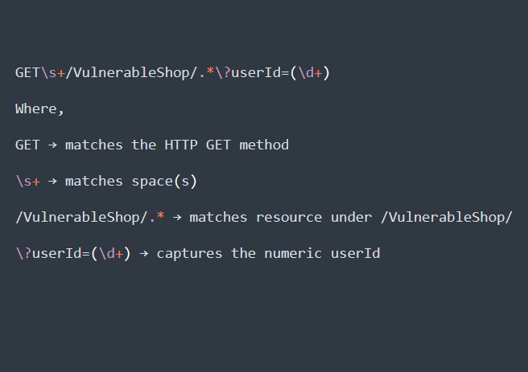
Fuzzing detection
Regex Pattern

Slide 17
Queries ?
Thanks

